Slide 1
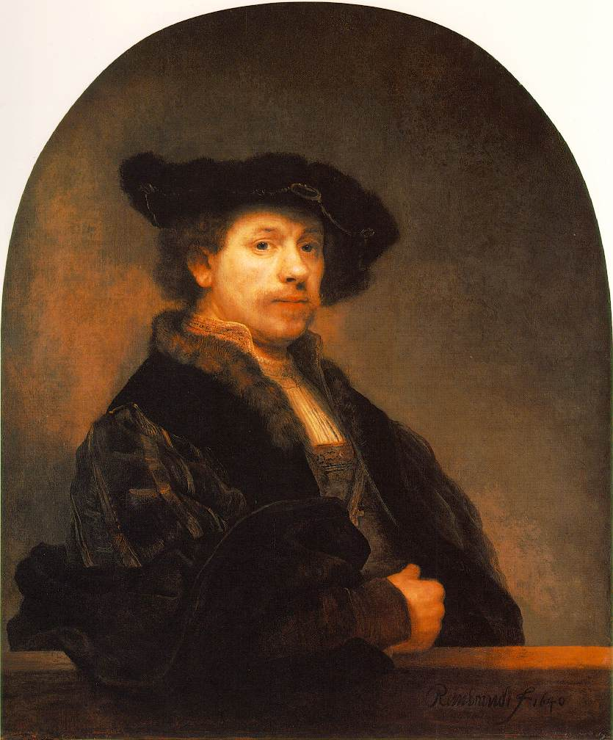
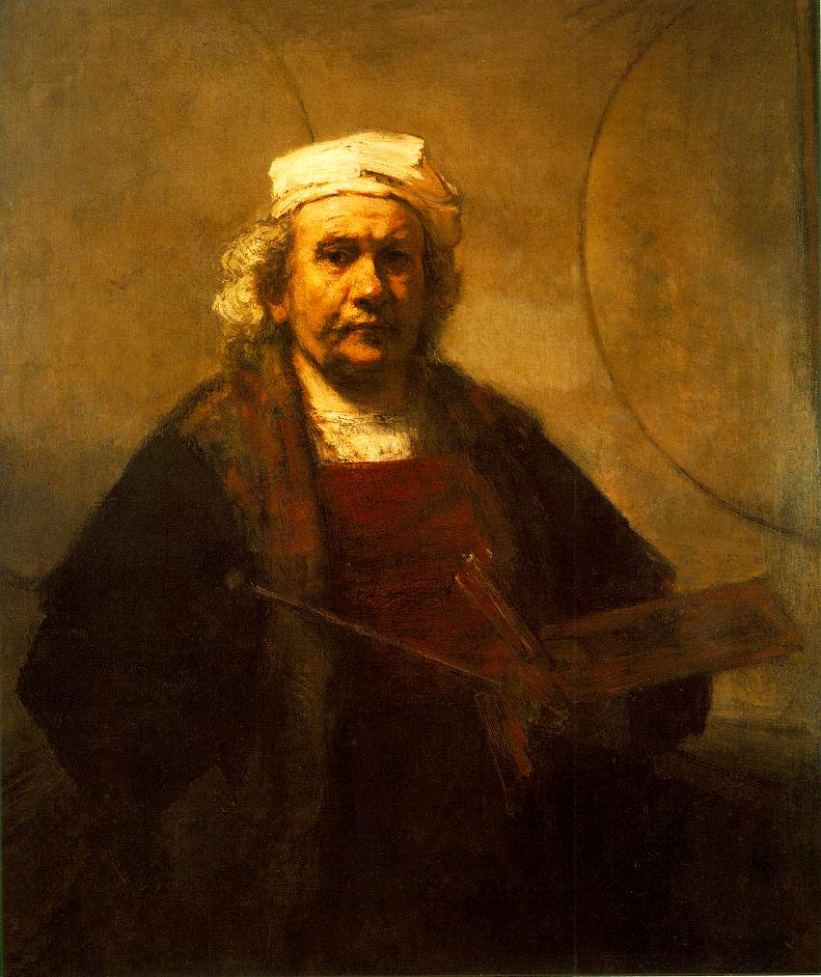
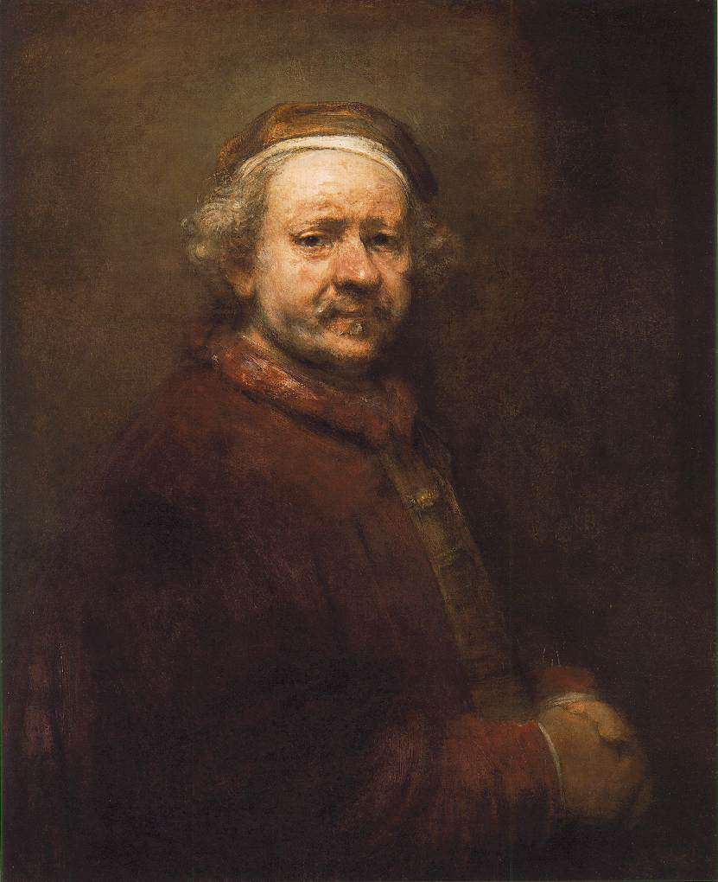
autoportrét REMBRANDT (1606 – 1669)
1640
1661
1669

Slide 2
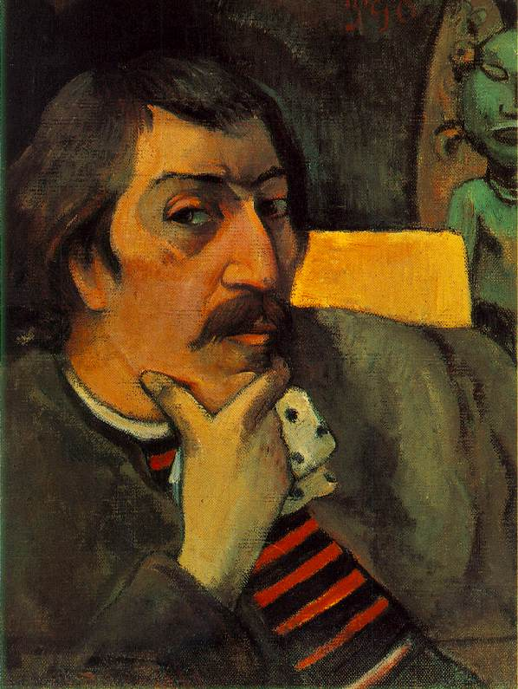
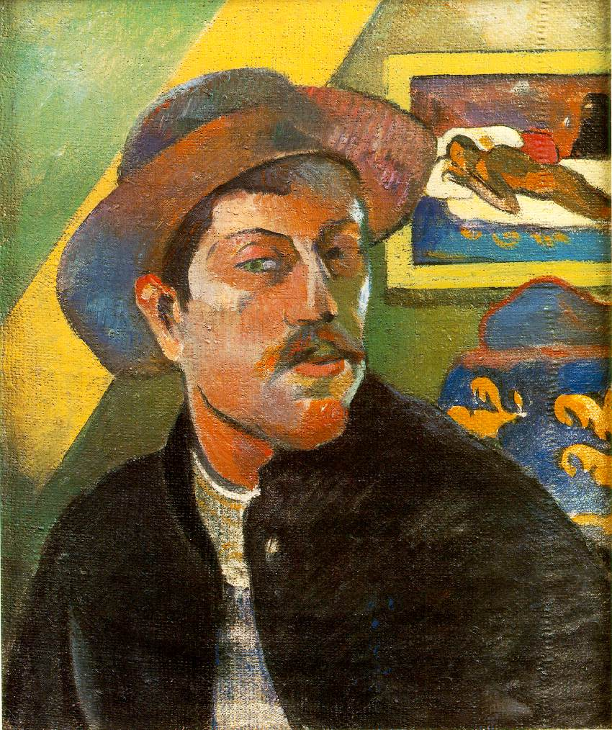
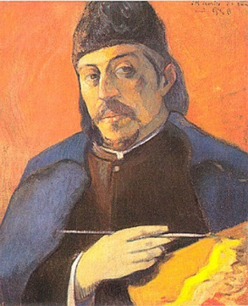
autoportrét PAUL GAUGUIN (1848 – 1903)
1893
1893
1894

Slide 3
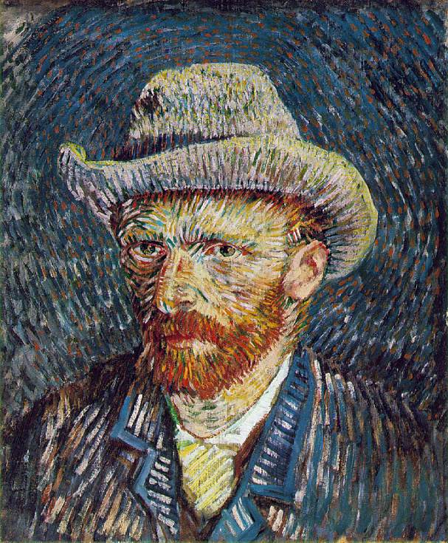
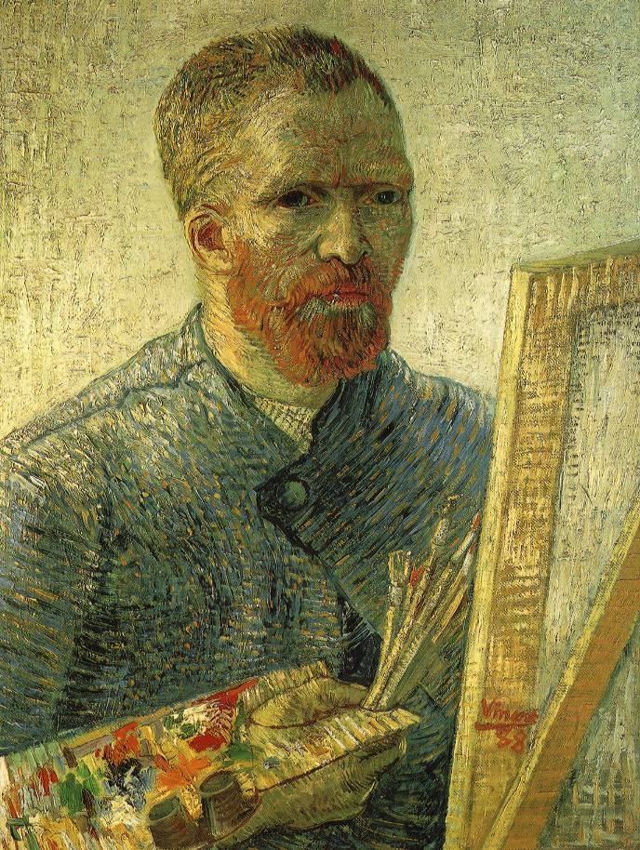
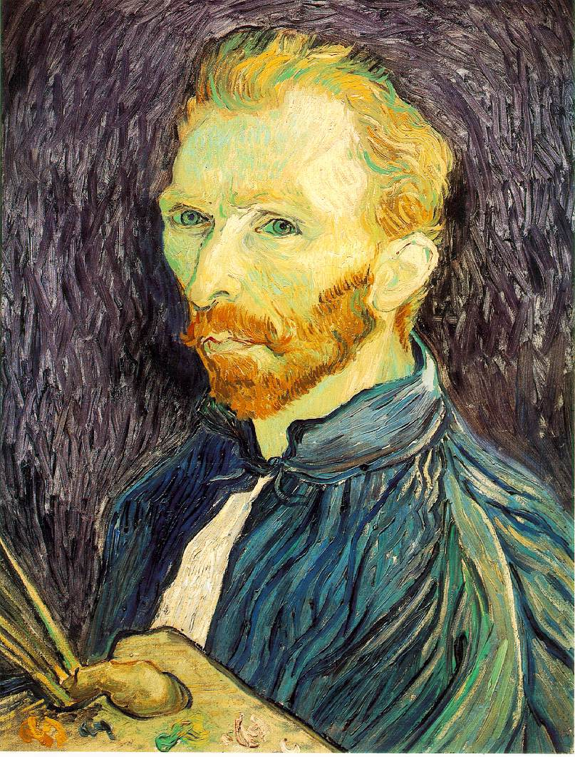
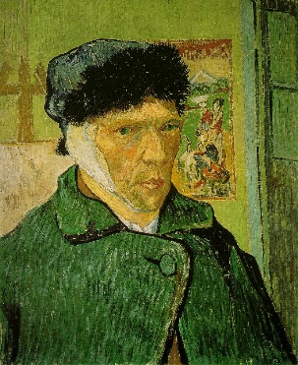
autoportrét VINCENT VAN GOGH (1853 – 1890)
1887
1887
1889
1889
https://commons.wikimedia.org/wiki/Category:Self-portrait_paintings_by_Vincent_van_Gogh

Slide 4
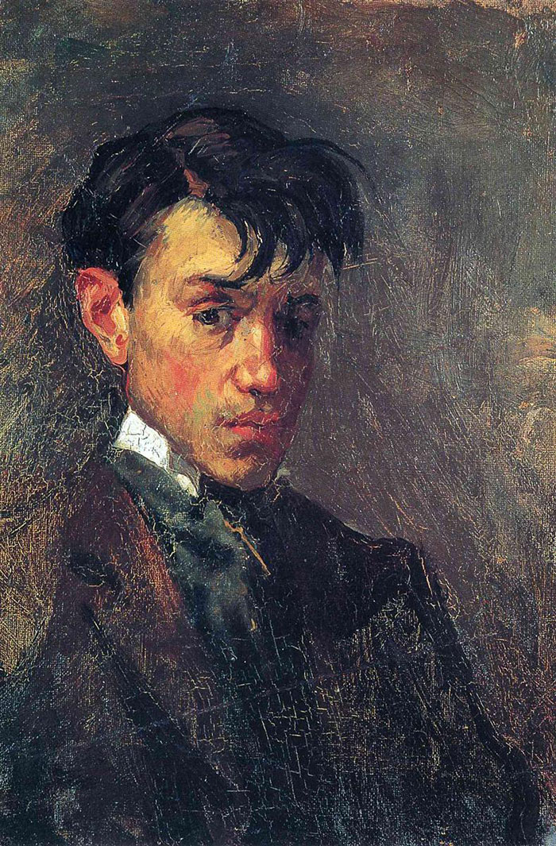
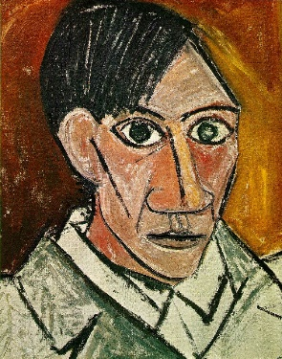
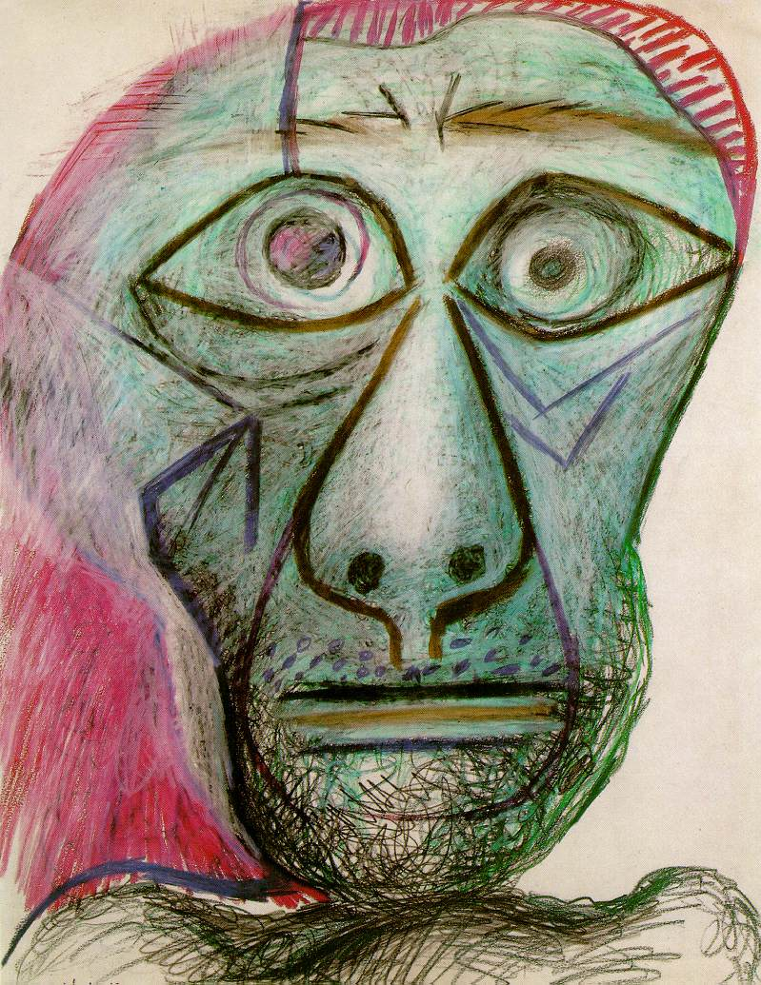
autoportrét PICASSO (1881 – 1973)
1896 – 15 let
1907 – 66 let
1972 - 90 let

